Slide 1

Understanding how interfaces affect users

Slide 2

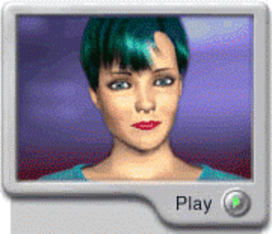
Overview
Expressive interfaces
  how the ‘appearance’ of an interface can elicit positive responses
Negative aspects
  how computers frustrate users
Anthropomorphism and interface agents
  The pros and cons
Designing synthetic characters

Slide 3
Affective aspects
HCI has generally been about designing efficient and effective systems
Recently, move towards considering how to design interactive systems to make people respond in certain ways
  e.g. to be happy, to be trusting, to learn, to be motivated

Slide 4

Expressive interfaces
Colour, icons, sounds, graphical elements and animations are used to make the ‘look and feel’ of an interface appealing
  Conveys an emotional state
In turn this can affect the usability of an interface
  People are prepared to put up with certain aspects of an interface (e.g. slow download rate) if the end result is very appealing and aesthetic

Slide 5
Friendly interfaces
Microsoft pioneered friendly interfaces for technophobes - ‘At home with Bob’ software
3D metaphors based on familiar places (e.g. living rooms)
Agents in the guise of pets (e.g. bunny, dog) were included to talk to the user
  Make users feel more at ease and comfortable

Slide 6
User-created expressiveness
Users have created emoticons - compensate for lack of expressiveness in text communication:
    Happy :)
    Sad :<
    Sick :X
    Mad >:
    Very angry >:-(
Also use of icons and shorthand in text and instant messaging has emotional connotations, e.g.
    I 12 CU 2NITE

Slide 7
User frustration
Many causes:
  When an application doesn’t work properly or crashes
  When a system doesn’t do what the user wants it to do
  When a user’s expectations are not met
  When a system does not provide sufficient information to enable the user to know what to do
  When error messages pop up that are vague, obtuse or condemning
  When the appearance of an interface is garish, noisy, gimmicky or patronizing

Slide 8
Error messages
“The application Word Wonder has unexpectedly quit due to a type 2 error.”
Why not instead:
“the application has expectedly quit due to poor coding in the operating system”
Shneiderman’s guidelines for error messages include:
    avoid using terms like FATAL, INVALID, BAD
    Audio warnings
    Avoid UPPERCASE and long code numbers
    Messages should be precise rather than vague
    Provide context-sensitive help

Slide 9
Website error message…

Slide 10
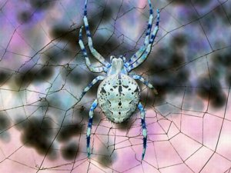
More helpful error message
“The requested page /helpme is not available on the web server.
If you followed a link or bookmark to get to this page, please let us know, so that we can fix the problem. Please include the URL of the referring page as well as the URL of the missing page.
Otherwise check that you have typed the address of the web page correctly.
The Web site you seek
Cannot be located, but
Countless more exist.”

Slide 11
Should computers say they’re sorry?
Reeves and Naas (1996) argue that computers should be made to apologize
Should emulate human etiquette
Would users be as forgiving of computers saying sorry as people are of each other when saying sorry?
How sincere would they think the computer was being? For example, after a system crash:
  “I’m really sorry I crashed. I’ll try not to do it again”
How else should computers communicate with users?

Slide 12

Anthropomorphism
Attributing human-like qualities to inanimate objects (e.g. cars, computers)
Well known phenomenon in advertising
  Dancing butter, drinks, breakfast cereals
Much exploited in human-computer interaction
  Make user experience more enjoyable, more motivating, make people feel at ease, reduce anxiety

Slide 13
Which do you prefer?
1. As a welcome message
“Hello Chris! Nice to see you again. Welcome back. Now what were we doing last time? Oh yes, exercise 5. Let’s start again.”
“User 24, commence exercise 5.”

Slide 14
Which do you prefer?
2. Feedback when get something wrong
“Now Chris, that’s not right. You can do better than that.Try again.”
“Incorrect. Try again.”
Is there a difference as to what you prefer depending on type of message? Why?

Slide 15
Evidence to support anthropomorphism
Reeves and Naas (1996) found that computers that flatter and praise users in education software programs -> positive impact on them
“Your question makes an important and useful distinction. Great job!”
Students were more willing to continue with exercises with this kind of feedback

Slide 16
Criticism of anthropomorphism
Deceptive, make people feel anxious, inferior or stupid
People tend not to like screen characters that wave their fingers at the user & say:
  Now Chris, that’s not right. You can do better than that.Try again.”
Many prefer the more impersonal:
  “Incorrect. Try again.”
Studies have shown that personalized feedback is considered to be less honest and makes users feel less responsible for their actions (e.g. Quintanar, 1982)

Slide 17

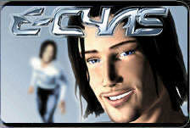
Virtual characters
Increasingly appearing on our screens
  Web, characters in videogames, learning companions, wizards, newsreaders, popstars
Provides a persona that is welcoming, has personality and makes user feel involved with them

Slide 18


Disadvantages
Lead people into false sense of belief, enticing them to confide personal secrets with chatterbots (e.g. Alice)
Annoying and frustrating
  E.g. Clippy
Not trustworthy
  virtual e-commerce assistants?

Slide 19



Miss boo.com
What
do you
think
of Miss boo?

Slide 20



Persuasive advice?

Slide 21
Virtual sales agents
What do the virtual agents do?
Do they elicit an emotional response in you?
Do you trust them?
Is the style of interaction different for men and woman’s clothes?
What facial expression does Miss.boo have?
Is she believable, pushy, helpful?
Would it be different if she was a male figure?

Slide 22
Virtual characters: agents
Can be classified in terms of the degree of anthropomorphism they exhibit:
  Synthetic characters
  animated agents
  emotional agents
  embodied conversational agents

Slide 23
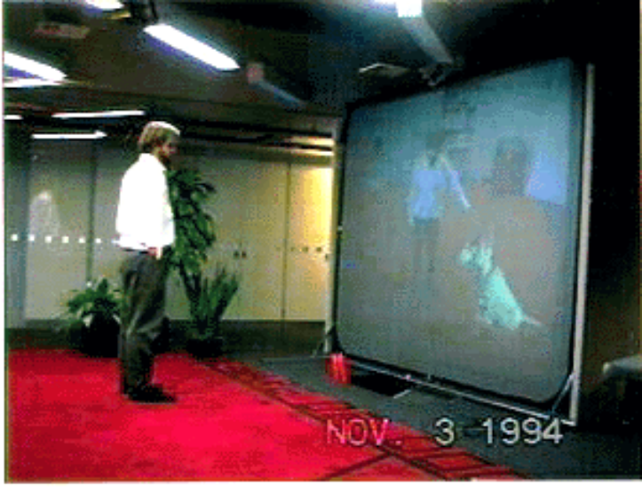
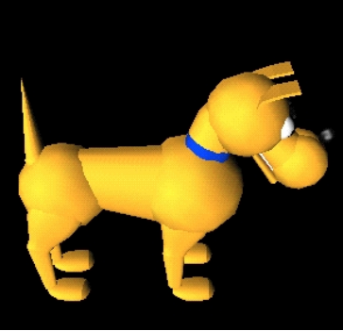
(i)Synthetic characters -Silas the dog
• autonomous, with internal states and able to
respond to external events
(Blumberg, 1996 - MIT)

Slide 24
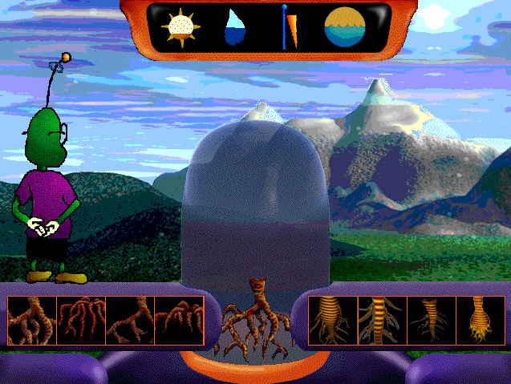
(ii) Animated agents
Play a collaborative role at the interface
Often cartoon-like
e.g. Herman the bug
(Lester et al, 1997
Intellimedia)
flies into plants
& explains things
on-the-fly & gives
advice to students

Slide 25
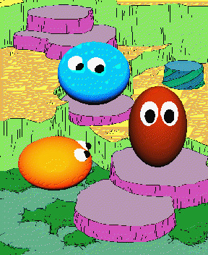
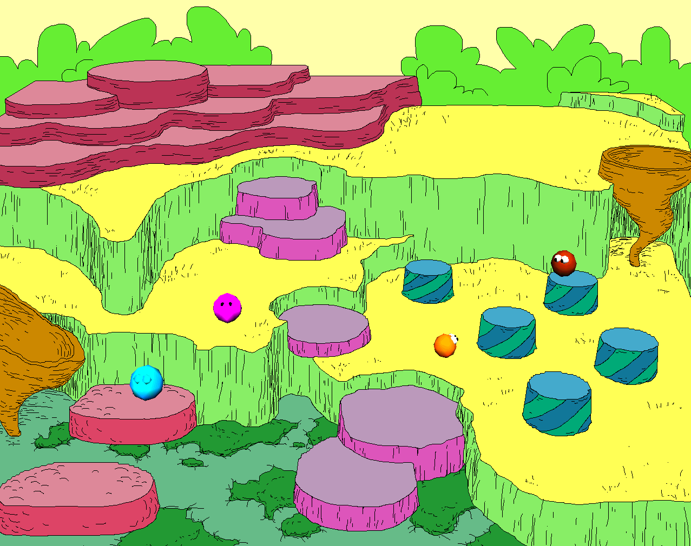
(iii) Emotional agents
Pre-defined personality and set of emotions that user can change
The Woggles, Bates, 1994

Slide 26
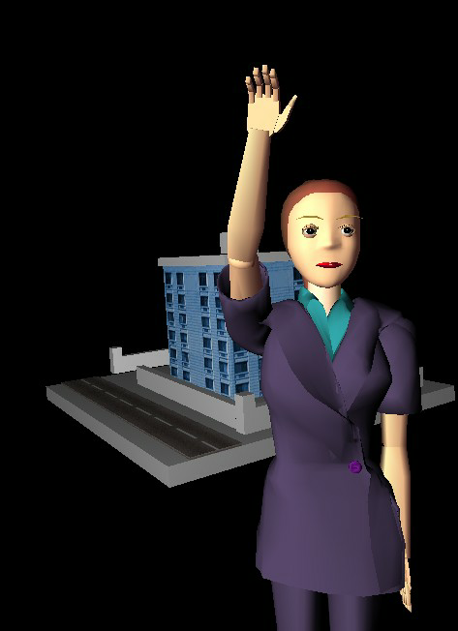
(iv) Embodied conversational agents
Rea, real-estate agent,
showing user
an apartment
Human-like body
Uses gesture, non-verbal
communication (facial
expressions, winks)
while talking
Sophisticated AI
techniques used to
enable this form of interaction
Cassell, 2000, MIT

Slide 27
Conversation with Rea
Mike approaches screen and Rea turns to face him and says:
Hello. How can I help you?
Mike: I’m looking to buy a place near MIT.
Rea nods, indicating she is following.
Rea: I have a house to show you. (picture of a house appears on the screen)
Rea: it is in Somerville.
Mike: Tell me about it.
Rea looks up and away while she plans what to say.
Rea: It’s big.
Rea makes an expansive gesture with her hands.
Mike brings his hands up as if to speak, so Rea does not continue, waiting for him to speak.
Mike: Tell me more about it.
Rea: Sure thing. It has a nice garden...

Slide 28
Which is the most believable agent?
Believability refers to the extent to which users come to believe an agent’s intentions and personality
Appearance is very important
  Are simple cartoon-like characters or more realistic characters, resembling the human form more believable?
Behaviour is very important
  How an agent moves, gestures and refers to objects on the screen
  Exaggeration of facial expressions and gestures to show underlying emotions (cf animation industry)

Slide 29
Key points
Affective aspects are concerned with how interactive systems make people respond in emotional ways
Well-designed interfaces can elicit good feelings in users
Expressive interfaces can provide reassuring feedback
Badly designed interfaces make people angry and frustrated
Anthropomorphism is increasingly used at the interface, in the guise of agents and virtual screen characters

